Slide 1
Early Rock and Roll
The music that
changed everything

Slide 2
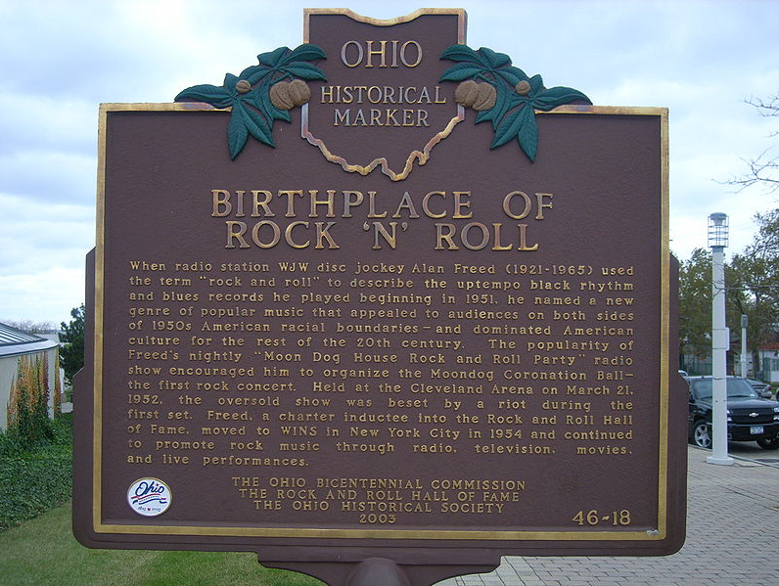
Origins
Started 1940’s through 1950’s
From Jazz, Blues & Country
Blues beat, off beat
Combined different cultures

Slide 3
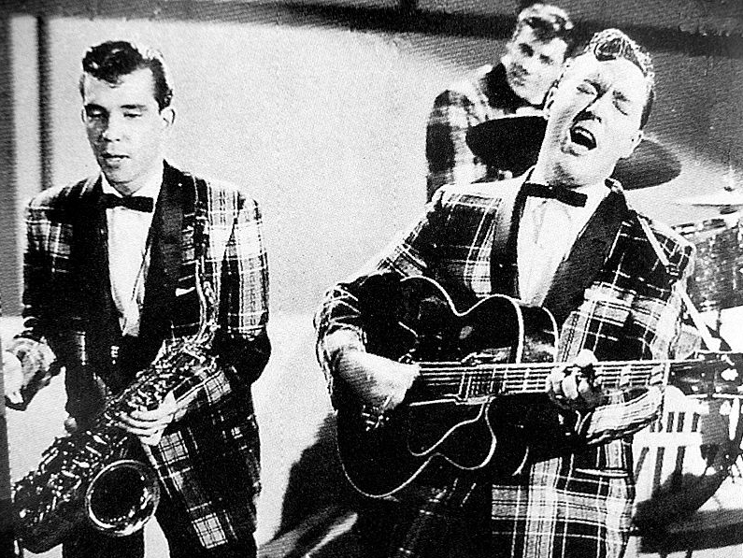
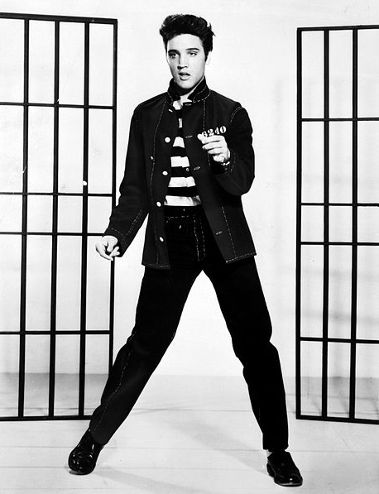
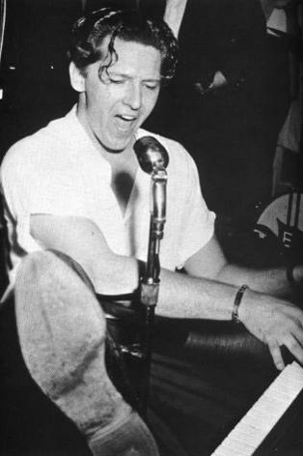
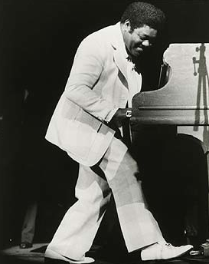
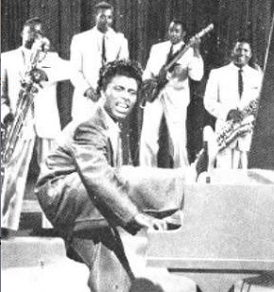
Origins
Who made Rock and Roll
Music popular?
Bill Haley and his Comets
Elvis
Jerry Lee Lewis
Fats Domino
Little Richard

Slide 4
Origins
Let’s hear about Alan Freed
and Early Rock and Roll
on the radio
Go to Next Slide
Alan Freed – The first man to label Rock and Roll and play on Radio
Played music that crossed racial boundaries

Slide 5
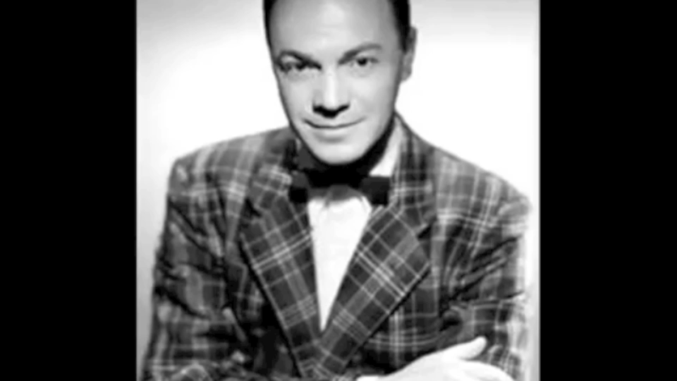

Slide 6
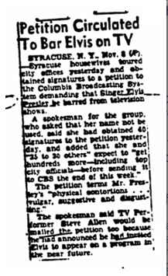
Origins
Parents and Rock and Roll
Kids and Rock and Roll
Elvis and his HIPS!

Slide 7
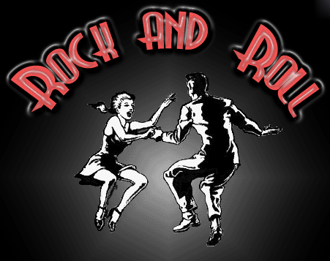
Origins
Opened doors for different Music & Different Artists
Instruments
Different style of Dancing
This is the start of something GREAT!

